Slide 1

ODE Simulation: Hodgkin-Huxley Action Potential Model
MATH 7205-Fall 2020
Joshua Galloway
Notes:
Did my project on Hodgkin Huxley model
Nonlinear ODE simulation

Slide 2
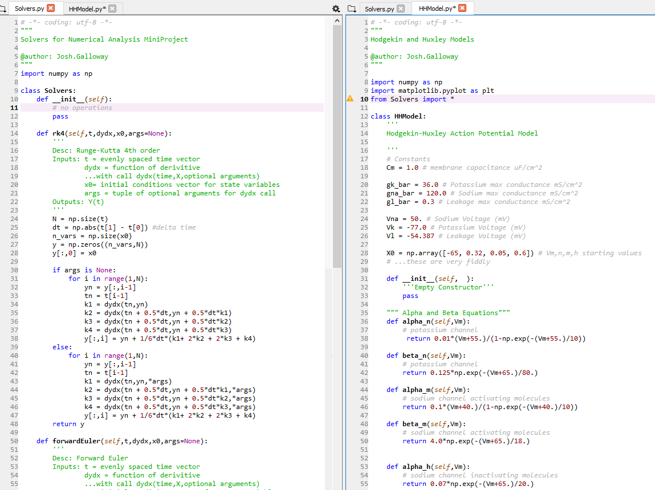
Presentation Outline
Introduction
Hodgkin-Huxley Model Introduction
Model
Electrical Circuit
System of ODE’s
Coefficient Functions
Fixed Parameters
Simulation
Methods Used
Comparison to Original Paper’s Simulation
Phase Plane
Stability and Accuracy
Stability of Different Methods for Varied ∆t
Error of Different Methods for Varied ∆t
Conclusion
Notes:
Read Bullets

Slide 3
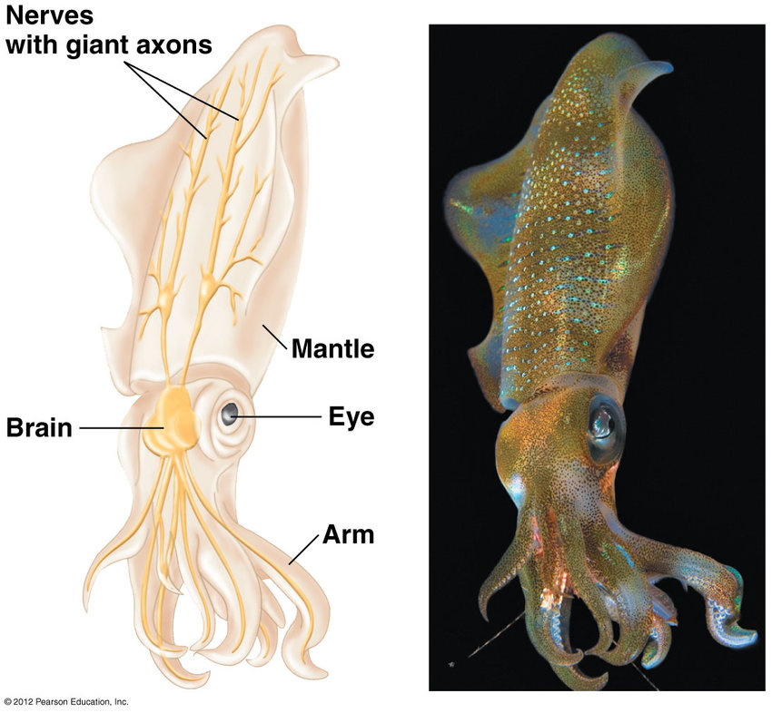
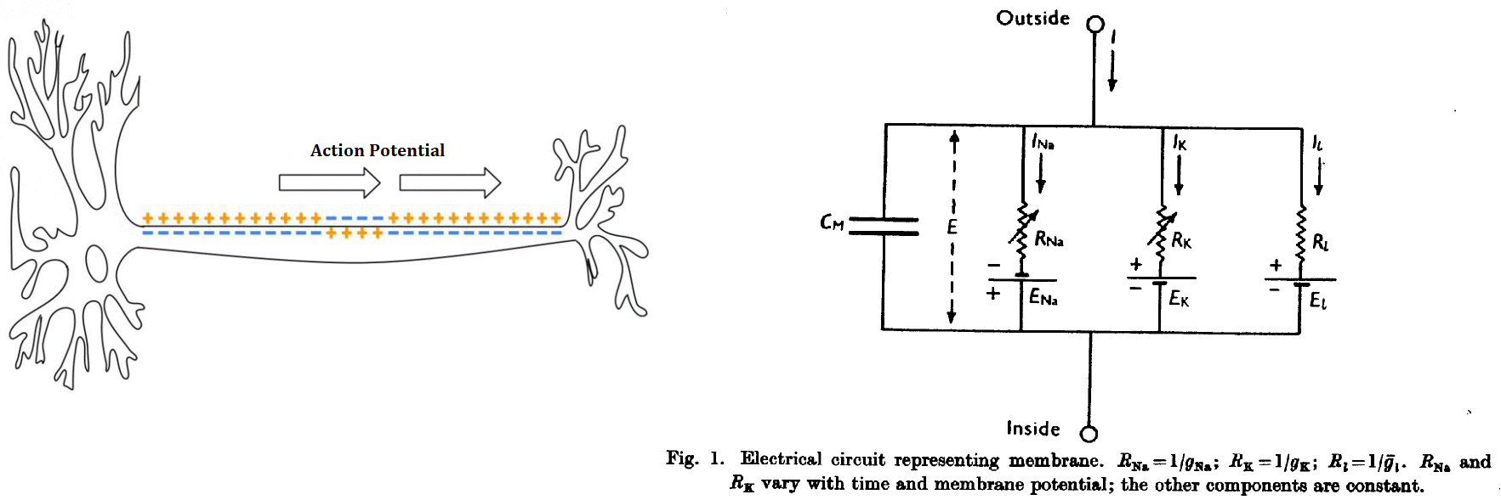
Introduction
Hodgkin-Huxley Model:
Created in 1952 to explain the ionic mechanisms underlying the initiation and propagation of action potentials in the squid giant axon
Received the Nobel Prize in Physiology and Medicine for this work in 1963
Electrical model of action potentials in neurons created from experiments on squid giant axons
Set of 4 non-linear Autonomous ODE‘s
References: [1], [2], [3]
Notes:
Read Bullets

Slide 4
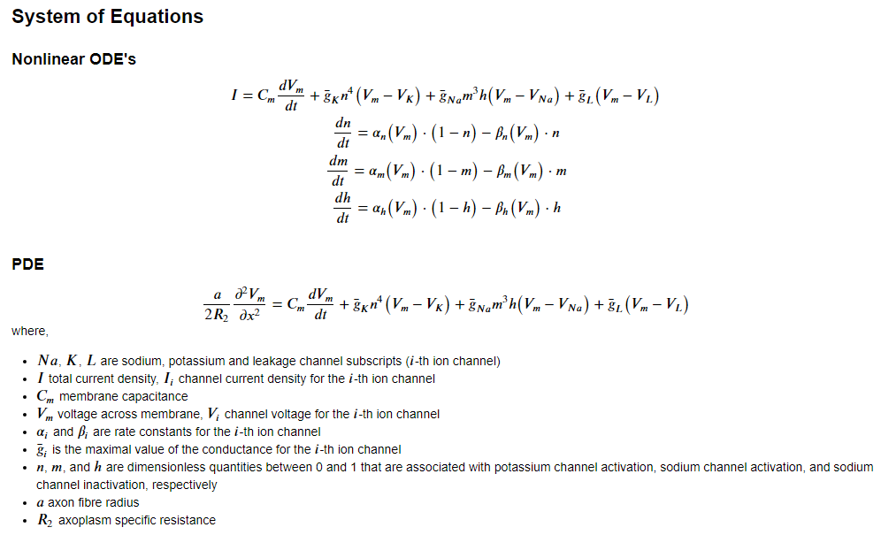
Model
[1]
Notes:
Electrical Circuit
Variable conductances for potassium, sodium and leakage/loss parallel branches
Fixed counter emf voltages
Fixed capacitance for cell membrane
Total Current Equation
Forcing Function
Channel variables
Dimensionless
Alpha and Beta Nonlinear Coefficients
PDE
Total current replaced with second spatial derivative
Resembling heat equation

Slide 5
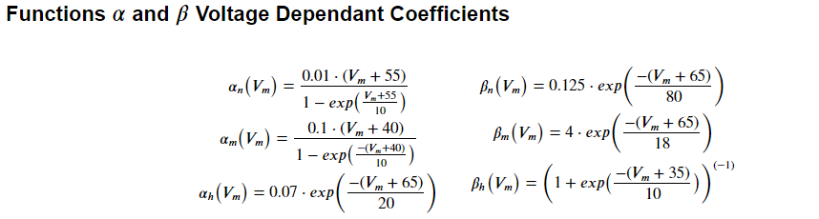
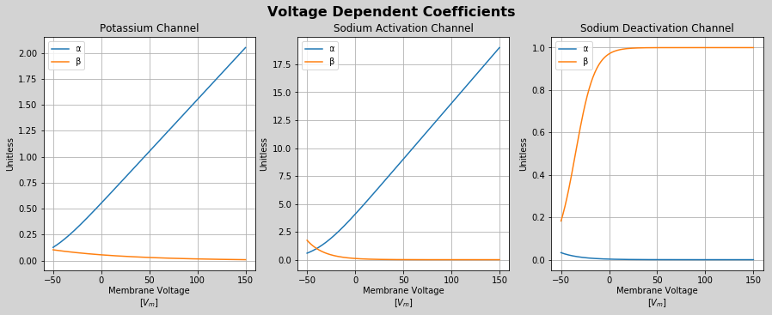
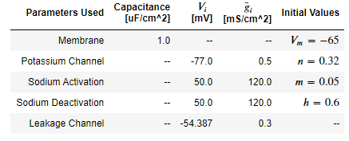
Model (continued)
Notes:
Alpha and Beta are dependent on membrane voltage
The parameters are fit from the original experiments
Mention graph
Table of other parameters used
Fixed channel voltages,
Maximum conductances
Initial conditions for ODE

Slide 6
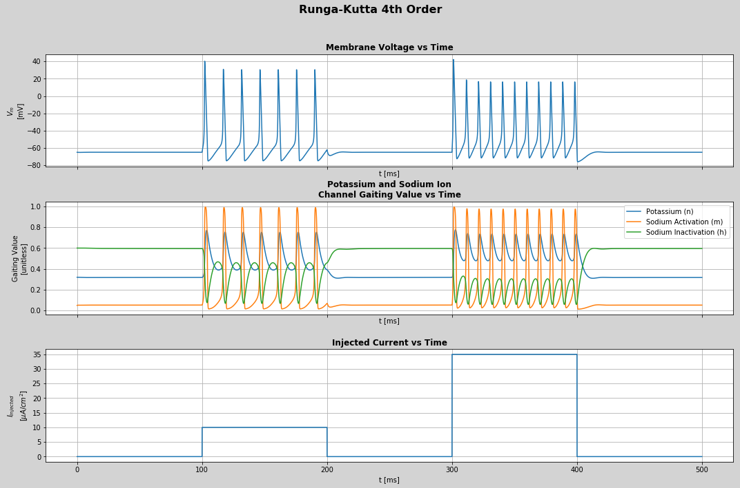
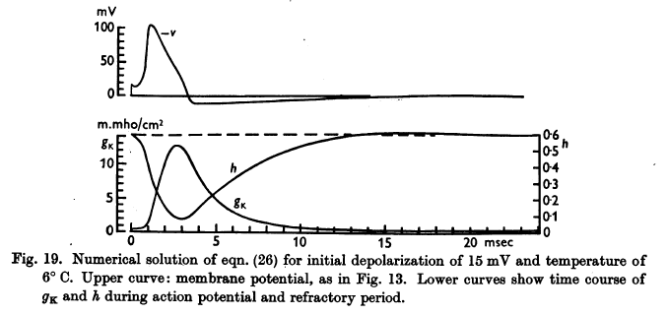
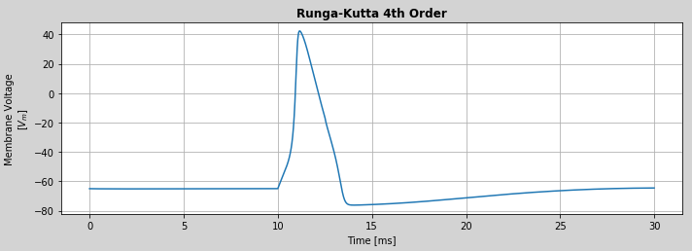
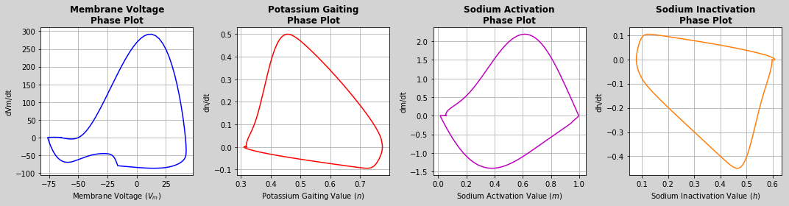
Simulation
Forward Euler, Huen’s Method, and 4th Order Runga-Kutta Implemented from Scratch in Python using Numpy
[1]
Notes:
Methods
Forward Euler, Huen’s Method, and Runga-Kutta 4th Order
Implemented in Python with aid of Numpy Library
Spike Graph
Produced by forcing with a 3 ms input current
Compared to shape of simulation in original paper using Backward Euler (I believe)
Phase Plots
Closed, suggesting limit cycles
Second Graph
Runga Kutta
Injected Current for longer periods and different magnitude
Limit Cycles as expected
Larger Current increases the period of the cycles as expected

Slide 7
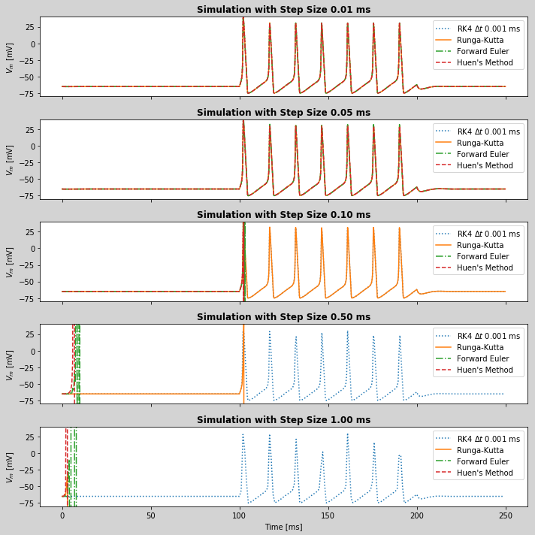
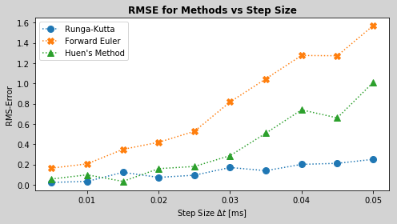
Stability and Accuracy
Vary Step Size for Simulation and Observe when the Methods become Unstable
Compare Each Simulation to a Benchmark of Runga-Kutta 4th Order with a Step Size of 0.001 ms
Calculate the Root Mean Squared Error for Step Sizes in [0.005,0.05] and Compare Against the Benchmark
Notes:
Stability
Analytic Solution to stability non-trivial
Experiment: Vary Step size and find out when each method breaks
Graph, RK best, Heuns next and the FE as expected
Error
Ad-hoc method
Simulate with RK at 1 microsecond step size as benchmark
Compare the other simulations to interpolated benchmark and calculate RMSE
Graph
FE and HM error accelerates as it approaches the breaking point
RK stays relatively the same

Slide 8
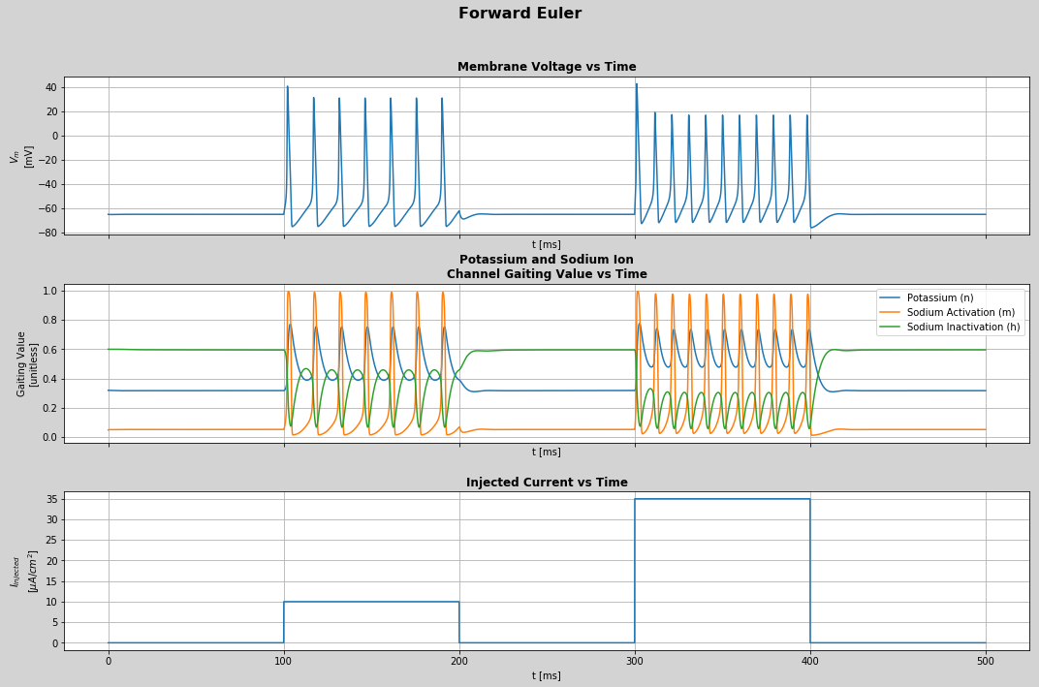

Conclusion
We Saw…
Model
Electrical Circuit, Model Equations
Simulation
Forward Euler, Huen’s Method, Runga-Kutta 4th Order
Simulations all Matched the Original Paper with Proper Parameter Selection
Stability and Accuracy
Runga-Kutta Performed Best in both Stability and Accuracy followed by Huen’s Method then Forward Euler as would be Expected
Questions?....
Notes:
Read Bullets
Future work would include more efforts around simulating the PDE
Questions?

Slide 9
References
Hodgkin AL and AF Huxley. A quantitative description of membrane current and its application to conduction and excitation in nerve. J. Physiol., 117:500–544, 1952
Hodgkin–Huxley model (2020, May 22). Retrieved Oct 08, 2020, from https://en.wikipedia.org/wiki/Hodgkin-Huxley_model
A Computational View of the Historical Controversy on Animal Electricity - Scientific Figure on ResearchGate. Available from: https://www.researchgate.net/figure/The-squid-giant-axon-The-giant-axon-is-a-very-large-up-to-1-mm-in-diameter-and-long_fig2_276491039 [accessed 21 Oct, 2020]

